Slide 1
MLOps with Azure Machine Learning

Slide 2
What you'll learn:-
➡ How to use Azure Machine Learning from Development to Production
➡ How to automate End 2 End machine Learning Solution on Azure
➡ Run an end-to-end CI/CD MLOps pipeline using Azure DevOps & Azure Machine learning
➡ How to Use Azure DevOps for Continuous Integration, continuous deployment on Machine Learning
➡ Bests practices and highly demanded capabilities of machine learning on Azure Cloud

Slide 3
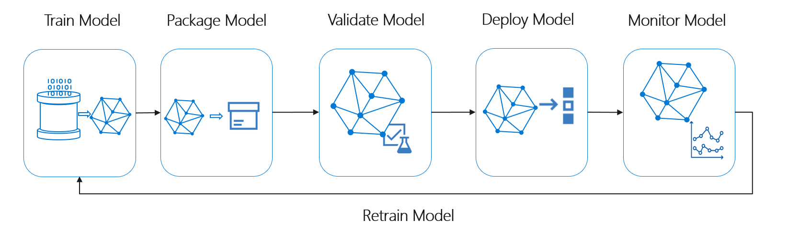

Slide 4
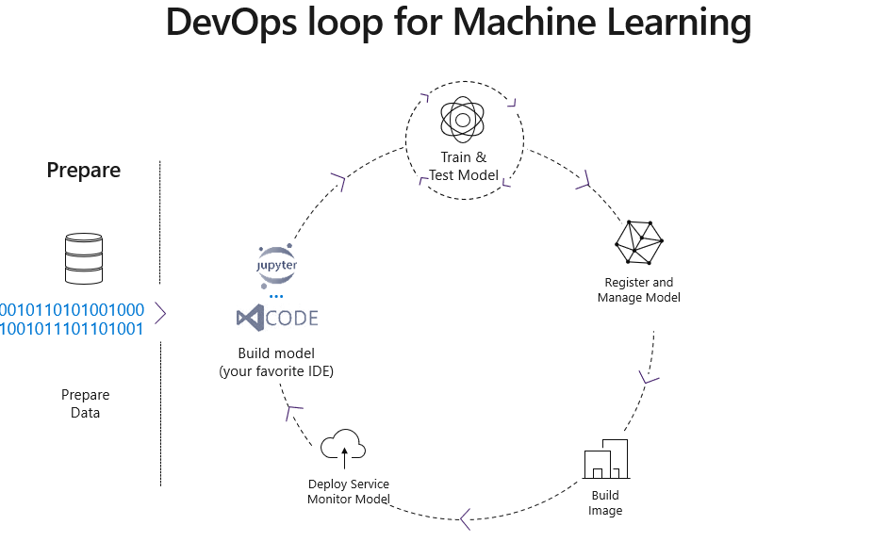

Slide 5
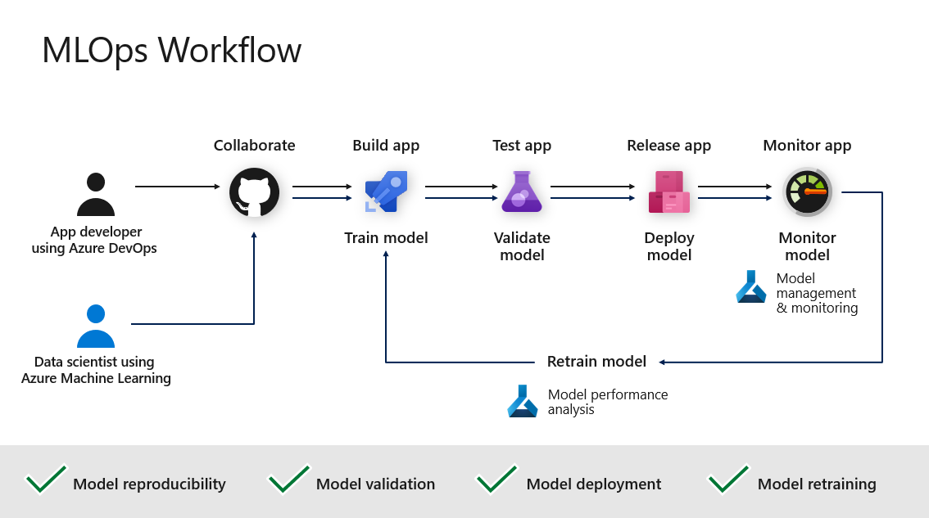

Slide 6
➡ Daywise Syllabus: https://docs.google.com/document/d/1N0p0AFR0zH4lg2VZTgp73LmlKZ2MAV45SYI4KzLcwLY/edit?usp=sharing
➡ Instructor Profile: https://www.linkedin.com/in/sachin-saxena-graphic-designer/
➡ Registration Link: https://forms.gle/5VxqwnMLuqdoJwKb9
➡ Demo Link: https://sachinsaxena.graphy.com/courses/Data-Engineering--676d508b2eee327ebbe53b2b
➡ Job Assistance WhatsApp Group link: https://chat.whatsapp.com/CrFEmndkTJ2LLzuhxDu054
➡ Course Link: https://sachinsaxena.graphy.com/courses/End-to-End-Azure-Data-Engineering-with-AI--August-30-689d79bcbf3c722102ef97ee

